Slide 1
Unit III-
Understanding Harmony in the Human Being - Harmony in Myself!
Co-existence of the sentient ‘I’ and the material ‘Body’, Understanding the needs of Self (‘I’) and ‘Body’, Understanding the Body as an instrument of ‘I’, Understanding the characteristics and activities of ‘I’ and harmony in ‘I’, Understanding the harmony of I with the Body: programs to ensure Sanyam and Health.

Slide 2
Why should I study myself? / Getting to know the activities in the Self(“I”):
We spend most of our time ‘with’ ourselves, ‘in’ ourselves but we spend most of our time thinking about other things and neglect ourselves.
The Self (I) is the basis of everything we do. All our desires, expectations, thoughts, feelings, understanding etc. come from the “I”.
Studying our “Self” helps us to have more clarity about ourselves and makes us confident. It develops our understanding and helps in building good relationships with everyone. It also helps us to understand our program better.

Slide 3
Human being is co-existence of the Self and the Body
The human being is the co-existence of ‘I’ and the body, and there is exchange of information between the two, i.e. ‘I’ and body exist together and are related. There is a flow of information from‘I’ to the body and from body to the ‘I’. We can make this distinction between the self and the body in three ways in terms of the needs, activities and the types of these two entities. All the needs of I, say respect, trust, etc., can be called as Happiness (such), while the needs of body are physical facilities (suvidha) like food. The two things are qualitatively different. There is no relevance of quantity for the needs of I as it is qualitative, while the needs of body are quantitative, and they are limited in quantity.
The activities of ‘I’ are activities like, desire, thinking, selection, while the activities of body are activities like eating, breathing etc. The mode of interaction of ‘I’ includes knowing, assuming, recognizing and fulfilment. The fulfilment depends on recognition depends on assumptions and assumptions depends on knowing or not knowing (beliefs). If assuming is based on knowledge, then recognition will be correct and fulfilment will be correct. If assuming is not based on knowledge,then things may go wrong. The mode of interaction of body is only recognizing and fulfilling. Self is a conscious entity and the body is a material entity, or physic-chemical in nature.

Slide 4
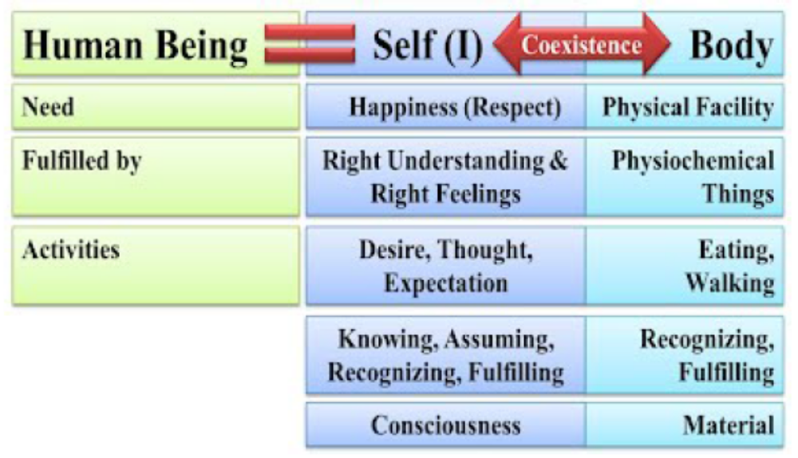
Human being is co-existence of the Self and the Body
To conclude we can say that the human being can be understood in terms of a co-existence of two entirely distinct entities, namely sentient ‘I’ and material body. Their needs and activities are quitedifferent and have to be understood accordingly. But these two constituents of human being are to actin close synergy with each other.

Slide 5

1) List out situations when you spend time with yourself?
2) Where do you like to go alone?

Slide 6
Activities of knowing, assuming, recognizing and fulfillment
The variety of activities that we are engaged in commonly
Activities that are going on in the self
Apart from the activities of Breathing, Heartbeat, Digestion etc.,
Recognizing → Fulfilling
2. Activities that are going on in the body
When it comes toself (jivan or ‘I’), which is a conscious entity; in addition to ‘recognizing and fulfilling’, there is also the activity of assuming and that of knowing. In fact, recognizing and fulfilling in case of humanbeings will depend upon knowing and/or assuming.
a. We assume- ‘assuming or mannana’.
b. We recognize- ‘recognizing or pahachaanana’
c. We fulfil- ‘fulfilling or nirvahakarna’
Taken together we can write it as (in I): Assuming → Recognizing → Fulfilling
3. Activities involving both the self and the body
Knowing, assuming, recognizing and fulfilling are the activities involving both the self and the body.

Slide 7
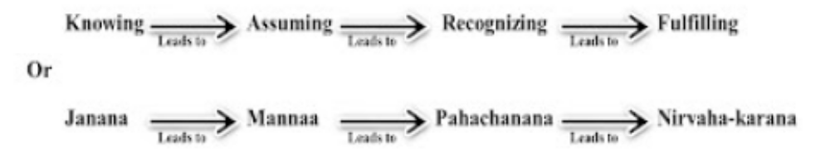
Activities of knowing, assuming, recognizing and fulfillment
There is another activity that exists in us (in ‘I’). This activity is called ‘knowing’. Knowing meanswe have the right understanding – the understanding of harmony at all levels of our living. When we have the right understanding, when we have the knowledge of reality, it is definite, and then assuming becomes according to the knowing, and hence recognizing and fulfilling becomes definite,or according to knowing.
 |  | ‘I’ | ‘Body’
Activities | Activities are. | Desiring, thinking etc. | Breathing, heart-beat, etc.
 |  | Knowing, assuming, recognizing, fulfilling | Recognizing, fulfilling

Slide 8
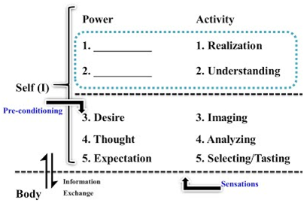
The Self “I” is conscious in nature while the “Body” is physico-chemical in nature. The interaction between ‘I’ and the ‘Body’ is in the form of exchange of information. The diagram shows two categories of attributes of the Self, namely, the powers of the Self (सक्ती) and the corresponding Activities (क्रिया) as the manifest outcome of these powers.
POWER: This is the basic capacity in the Self “I”. This includes
Desire (इच्छा)
Thought (विचार)
Expectation (Asa/Asha)
ACTIVITIES: These are the outcomes of the power of Self. They are Imaging (Chitrana/Chitran)
Analyzing (विशलेशन)
Selecting / Tasting (निवडा /Asvadana)
Activities in Self (I):

Slide 9
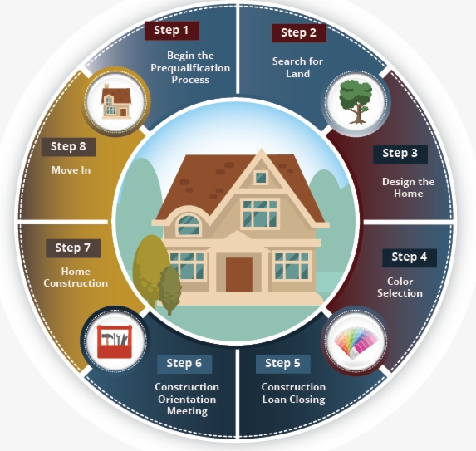
a desire- owner of a big house
This desire exists in the form of imaging
thoughts start working out
splitting up of the image analyzing
Expectation and Selecting size, colour etc.
Tasting-fulfillment of these expectations
Selecting and Tasting keeps going on

Slide 10
Home Assignment
Practical:
List down all your desires, Observe whether the desire is related to Self (I) or Body. If it appears to be related to both, see which part of it is related to Self (I) and which part is related to Body.
Home Work:
1. Write down 5 needs of your self and 5 needs of your body
2. Write down 5 activities of your self, 5 activities of your body and 5 activities of your body + self
3. Observe in yourself if the activities of your self are continuous or temporary

Slide 11
Needs of self and the needs of body needs of self and the needs of body needs of self and the needs of body
The human being is the co-existence of ‘I’ and the body, and there is exchange of information between the two. We can make this distinction between the self and the body in terms of the needs as shown in the table below
 |  | ‘I’ | ‘Body’
Needs | Needs are …. | Trust, Respect…. | Food, Clothing…
 |  | Happiness (sukh) | Physical Facilities (suvidha)
 | In time needs are… | Continuous | Temporary
 | In quantity, needs are... | Qualitative | Quantitative (limited in quantity)
 | Needs are fulfilled by….. | Right understanding and right Feelings | Food, clothing, etc

Slide 12
Human being is more than just the body needs of self and the needs of body needs of self and the needs of body
There is the familiar shape and structure of a human being that is immediately apparent to us and we imagine someone with similar human body-like features. But in addition to the body, there is also the aliveness of the person – the entity that keeps the body ‘alive’ and makes it operate in various ways.
We perceive this aliveness in the activities demonstrated by the person like their seeing, talking, listening, walking, and eating, etc. This aliveness is called Jivana. Thus, a human being is coexistence of the body and jivan. This jivan refers to itself as ‘I’ (self). Thus we say “I am so and so” or “I feel tired” or “I am happy” and not “my body is happy”. This I or self is also called ‘consciousness’ and is the sentient constitute of the human being.
The human being is the sum total of sentiments and physical aspect, the self (‘I’) and the body, and there is exchange of information between the two, i.e. ‘I’ and body exist together and are related.There is a flow of information from ‘I’ to the body and from body to the ‘I’. We can make this distinction between the self and the body in three ways in terms of the needs, activities and the types of these two entities.
All the needs of I, say respect, trust, etc., can be called as Happiness (such), while the needs of body are physical facilities (suvidha) like food. The two things are qualitatively different. There is no relevance of quantity for the needs of I as it is qualitative, while the needs of body are quantitative, and they are limited in quantity.

Slide 13
Understanding the Body as an instrument of ‘I’ needs of self and the needs of body needs of self and the needs of body
There is a relation between the self and body that body act as an instrument of self. Whatever self thinks body performs it physically. Body does not decide itself.
I am the seer (a person of supposed supernatural insight who sees visions of the future): When we are reading a book or listening, when someone is explaining something to us, when we are watching a scenery or when we are thinking – we are engaged in the activities of ‘seeing’ or understanding. Now when we see some nice scenery we say ‘I am seeing’ that means ourself ‘I’ see via the eyes, the eyes don’t see, they are just instruments, that unable me to see something outside. Different images are formed in the eyes every time, but it is I who is able to relate it to the meaning of that image every time. Similarly, I can see inside ‘in me’ also – without the eyes. For example I can see that I am getting angry. In this case I understand or know or am aware that I am getting angry. When I see outside the body works as an instrument.
I am the doer (a person who acts rather than merely talking or thinking): once I have seen/ understood something, I am the one who decides what to do or not to do. I am the doer. For example, when I see the scenery I am the one who decide to take a picture of the scenery. I use my hands to pick camera and click a picture. The hands in the body are thus used asan instrument. In this way I work with my hands and legs.
I am the enjoyer: I saw the scenery and I took the picture. I am the seer and doer so far. When I seethe picture I like it. I am the one that enjoys it. Thus there is a continuity of being the seer, doer andenjoyer. Similarly when I eat, I am the one that gets the taste – from the tongue.

Slide 14
Understanding the harmony of I with the Body: programs to ensure Sanyam and Health needs of self and the needs of body needs of self and the needs of body
Our present lifestyle and conditionings are not very conductive to keep the body fit and therefore it is important to understand sanyama and swasthya correctly and maintain proper harmony with the body. As a proposal, we need to work for the following few things
1. To understand and live with sanyama.
2. To understand the self organization of the body and ensure health of the body.
1. Understanding and Living with Sanyama: Sanyama implies that the self takes the responsibility for proper nurturing, and right utilization of the body. For this it is essential to understand the functioning of the body instrument, this instrument has a limited life span and undergoes a pattern of growth and decay.
2. Understanding the self organization of the body and ensure health of the body:
Nurturing of the Body: Proper Food, Air, Water, Etc.: process of selecting food for the body, to make out the elements which make a complete food so that it gives required nutrients and energy to the body, food needs to be eaten only when we feel hungry, choice of the food has to be such that it is easily digestible and the food needs to be taken with proper posture of the body and in right quantity.

Slide 15
Understanding the harmony of I with the Body: programs to ensure Sanyam and Health needs of self and the needs of body needs of self and the needs of body
b. Protection of the Body: cloths- ensure proper interaction of the body with the environment, the right amount of exposure of the body to the air, water, and sun is required to ensure its proper functioning.
To ensure the health (Swasthya) of the Body, we need to take care of the following- i) Ahar-Vihar, ii) Shram- Vyayam, iii) Asana-Pranayam and iv) Aushadhi-Chikitsa.
Proper upkeep (Vihar) of the Body: When we work, the Body gets tired. When we takerest, the Body becomes fit to work.
Labour: Labour is another requirement. It means employing the body physically for production and maintenance of physical facilities.
Physical Exercises:
Asan-Pranayam:
Treatment of the body:
c. Right Utilization of the Body (Sadupayoga): Right utilization of the body as an instrument necessitates understanding the purpose for which this instrument is to be used. Normally, we tend to believe that the body is an instrument for sensory enjoyment, which is not correct.

Slide 16
Human body is a self organized unit needs of self and the needs of body
The human body is a self organized and highly sophisticated mechanism. The body is made upof several organs and glands and the different parts of the body keep working in a close co-ordination. All the activities keep the body fit for the use of ‘I’ (self or jivana) so that ‘I’ and the bodymay work in synergy as a human being. The silent aspects of this harmony b/w ‘I’ and the body are:-
The body acts according to the needs of I.
There is harmony among the parts of the body.
What our body follow only by the permission of I.
There is a strong coupling b/w I and the body. If I am in disharmony e.g. in anger or stress or despair. It immediately starts affecting the body adversely.
There are many diseases of the body that are caused or accentuated due to disharmony in I. These are called psychosomatic diseases such as asthma, migraine, hyper-tension etc. On the other hand, when there is a strong disturbance in the body manifesting in the form of severe pain,it distracts I from its normal functions.
I have the feeling of sanyama for the body and the body has swasthya. Sanyama is basic to swasthya.

