Slide 1
Unit II-
Need, Basic Guidelines, Content and Process for Value Education
Self-Exploration, Natural acceptance, Continuous happiness and prosperity, Right understanding, relationship and physical facility, Understanding happiness and prosperity, Understanding and living in harmony at various levels.

Slide 2
Review of Previous Session
Meaning of Value Education:
Value Education is the education which enables to understand ‘what is valuable’ for human happiness. It is all about enabling a transformation in the human beings to help them move from Animal Consciousness to Human Consciousness.
Need for Value Education:
Correct identification of our aspirations
Understanding universal human values to fulfill our aspirations in continuity
Complementarity of values and skills
Evaluation of our beliefs
Technology and human values

Slide 3
Need for Value Education:
The subject that enables us to understand ‘what is valuable’ for human happiness is called value education. Need for value education is:
Correct identification of our aspirations. The subject which enables us to understand ‘what is valuable’ for human happiness is called ‘value education’ (VE). Thus, VE enables us to understand our needs and visualize our goals correctly and also indicate the direction for their fulfillment. It also helps to remove our confusions and contradictions and bring harmony at all levels.
Understanding universal human values to fulfill our aspirations in continuity. Values form the basis for all our thoughts, behaviours and actions. Once we know what is valuable to us, these values becomes the basis, the anchor for our actions. We also need to understand the universality of various human values, because only then we can have a definite and common program for value education. Then only we can be assured of a happy and harmonious human society.

Slide 4
Need for Value Education:
Complimentarily of values and skills. To fulfill our aspirations both values and skills are necessary. When we identify and set the right goals and produced in right direction. This is known as value domain, the domain of wisdom, and when we learn and practices to actualize this goal to develop the techniques to make this happen in real life, in various dimensions of human Endeavour (struggle). This is known as domain of skills. Hence, there is an essential complementarily between values and skills for the success of any human Endeavour. For example, I want to lead a healthy life. Only wishing for good health will not help me keep my body fit and healthy and without having understood the meaning of health, I will not be able to choose things correctly to keep my body fit and healthy.

Slide 5
Need for Value Education:
Evaluation of our beliefs. Each one of us believes in certain things and we base our values on these beliefs, are they false or true which may or may not be true in reality. These believes come to us from what we read, see, hear, what our parents tells us, our friends talk about, what them magazines talk of, what we see from TV etc. Value Education helps us to evaluate our beliefs and assumed values.
Technology and human values. The present education system has become largely skill-based. The prime emphasis is on science and technology. However, science and technology can only help to provide the means to achieve what is considered valuable. It is not within the scope of science and technology to provide the competence of deciding what really is valuable. Value Education is a crucial missing link in the present education system. Because of this

Slide 6
Process of value education
The process for value education has to be that of self-exploration, which includes two things: verification at the level of natural acceptance and experiential validation in living.
Self exploration is the process to find out what is valuable to me by investigating within myself, what is right for me, true for me, has to be judged within myself. Through self exploration we get the value of ourselves.
Various aspects of reality facilitating the understanding of human values will be presented as proposals. We need to verify these proposals for our self and examine our living in this light.

Slide 7
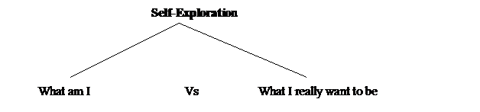
Self-Exploration
Value Education begins with Self-Exploration i.e. looking inside yourself.

Slide 8
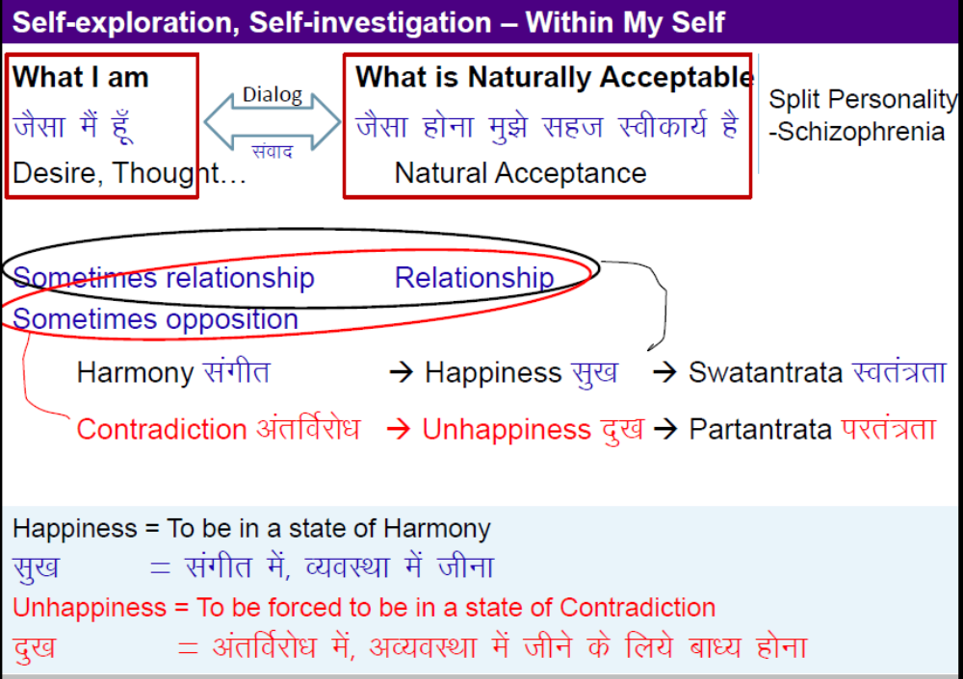
Self-Exploration (Continue)

Slide 9
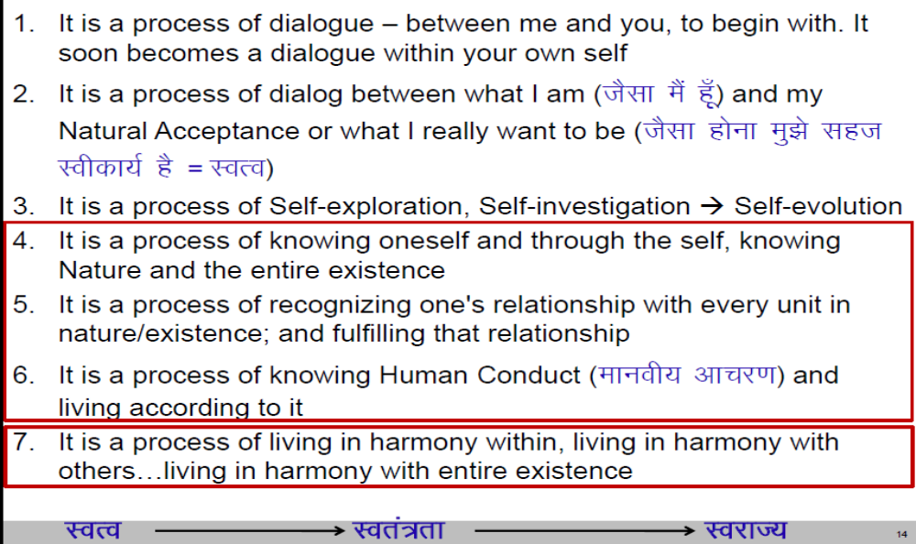
Process of Self-exploration, Self-investigation

Slide 10
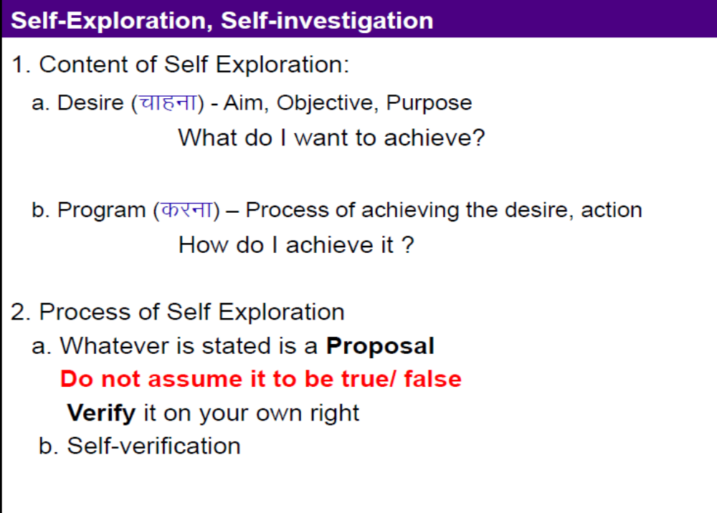

Slide 11
Process of Self-verification
Whatever is stated is a Proposal (Do not assume it to be true/ false)
Verify it on your own right
Proposal
1
2
Verify
on the basis
Of
your
Natural
Acceptance
Experiential Validation
Live according to it
2a
2b
Behaviour with
Human Beings
Work with
Rest of Nature
Mutual Happiness
Mutual Prosperity
RIGHT
UNDERSTANDING

Slide 12
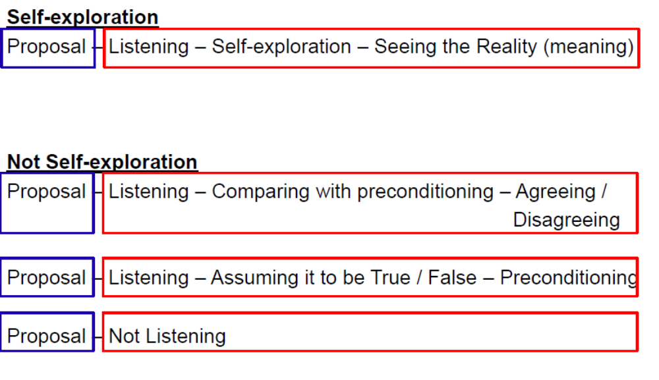

Slide 13
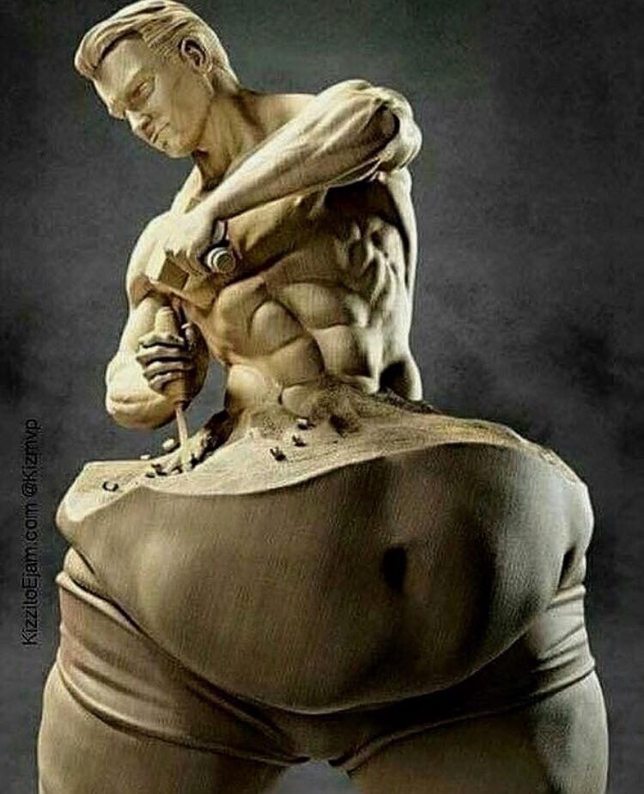
Self-evolution
Self-exploration
Verify the proposals
(on your own right)
    Right understanding of harmony at all levels
    Feeling and thought
    of harmony
    Harmonious behaviour, work and participation in larger order

Slide 14
Self-evolution
Define self exploration. What is the content of self – exploration?
ANS. Self exploration is the process to find out what is valuable to me by investigating within myself, what is right for
me, true for me, has to be judged within myself. Through self exploration we get the value of ourselves. We live with
different entirety (family, friends, air, soil, water, trees, etc.) and we want to understand our relationship with al these. For this we need to start observing inside.
The main focus of self-exploration is myself - the human being. Content of self exploration is just finding answers to the
following fundamental questions of all human beings:
1. The Desire/Goal: What is my (human) Desire/ Goal? What do I really want in life, or what is the goal of human life?
2. Program: What is my (human) program for fulfilling the desire? How to fulfill it? What is the program to actualize the above?
In short, the above two questions cover the whole domain of human aspirations and human Endeavour. Thus, they form the content of self- exploration.

Slide 15
What is happiness?
ANS. Happiness may be defined as being in harmony/synergy in the state/ situation that I live in. “A state or situation in which I live, if there is harmony in it then I like to be in that state/situation. The state of liking is happiness.” Happiness is a state of mind or feeling characterized by contentment, love, satisfaction, pleasure or joy. Happiness may be described as consisting of positive emotions and positive activities. There may be three kinds of happiness: pleasure, engagement, and meaning. In other words, freedom from want and distress, consciousness of the good order of things, assurance of one’s place in the universe or society, inner peace and so forth. Happiness is the state of mind, where we feel good in most of the walk of life.
What is the meaning of prosperity? How can you say that you are prosperous?
The feeling of having or making available more than required physical facilities is prosperity. Almost all of us feel that wealth alone means prosperity and try to explain this phenomenon on this nonexistent or half fact. We are trying to achieve happiness and prosperity by maximizing accumulation and consumption of physical facilities. It is becoming antiecological and anti-people, and threatening the human survival itself. For prosperity, two things are required-
Identification of the required quantity of physical facilities, and
Ensuring availability / production of more than required physical facilities.
We can be prosperous only if there is a limit to the need for physical facilities. If there is no limit what so ever be the availability the feeling of prosperity cannot be assured. Secondly, just assessing the need is not enough. We need to be able to produce or make available more than the perceived need.

Slide 16
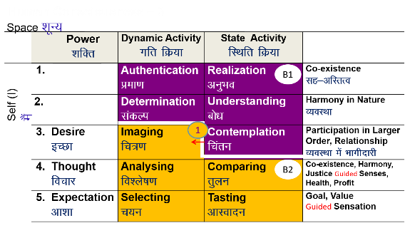
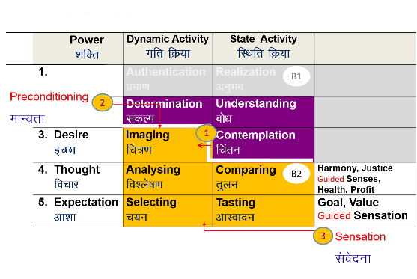
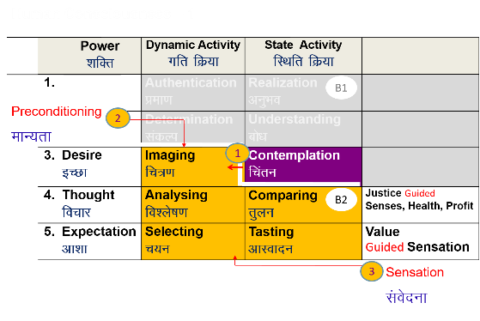
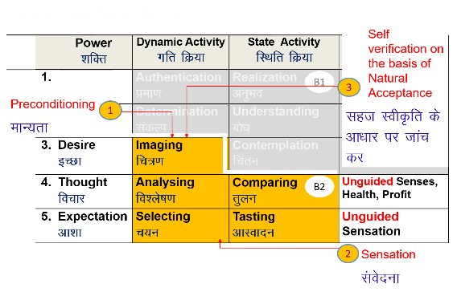
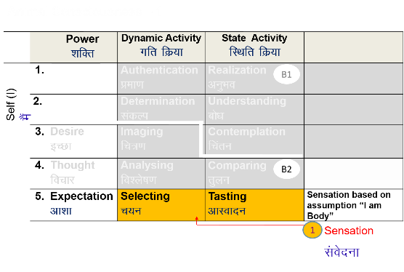
Self-evolution
Self-exploration
Self-verification
Human Consciousness
Living on the basis of knowing
Happiness by being in harmony within and harmony in all aspects of being
Acceptance of relationship – from one to many, to all [HAPPINESS]
Identifying need, production, right utilisation of physical facility [PROSPERITY]
Participation in larger order, expanding harmony [SOCIETAL DEVELOPMENT]
Transformation / Development
Living on the basis of assuming (without knowing)
Happiness from outside (through feeling from the other, sensual pleasure and physical facility)
Domination and opposition in relationship [UNHAPPINESS]
Exploitation and indulgence [DEPRIVATION]
Exploitation in larger order, increasing disorder [DEGRADING SOCIETY]
Animal Consciousness

Slide 17
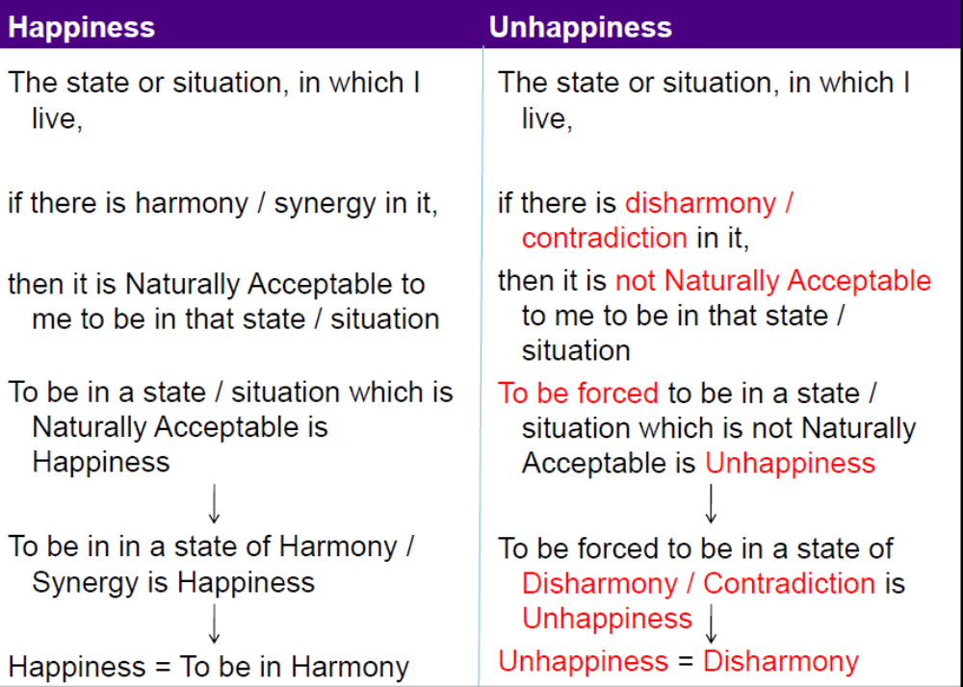
Continuous happiness and prosperity

Slide 18
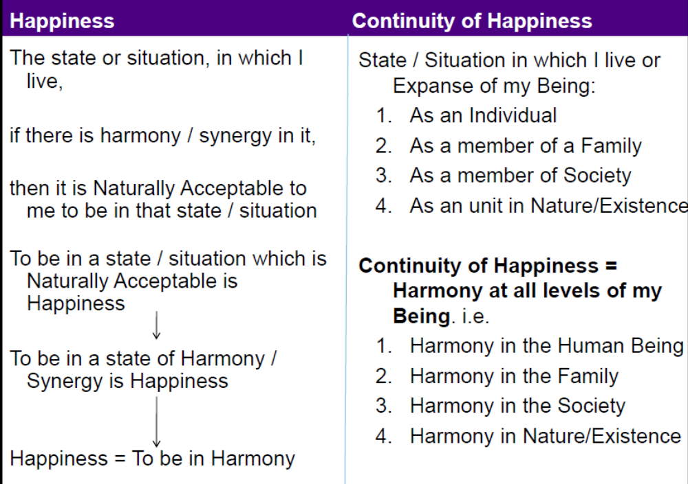
Continuous happiness and prosperity

Slide 19
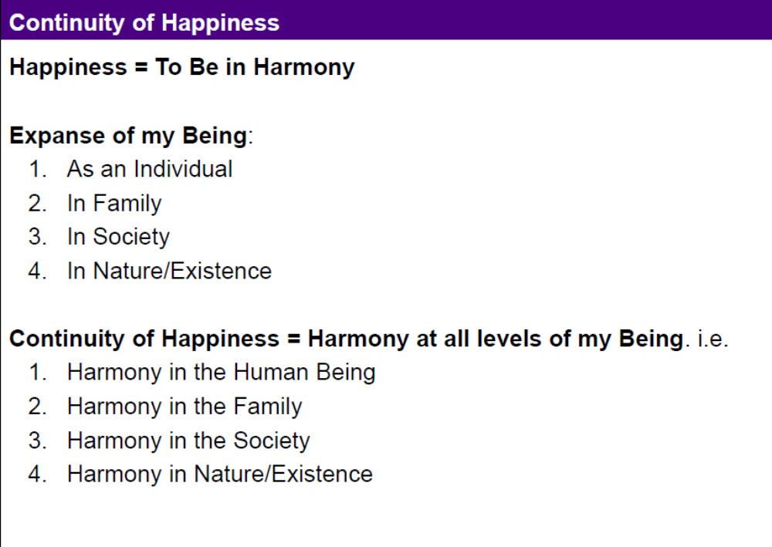
Continuous happiness and prosperity

Slide 20
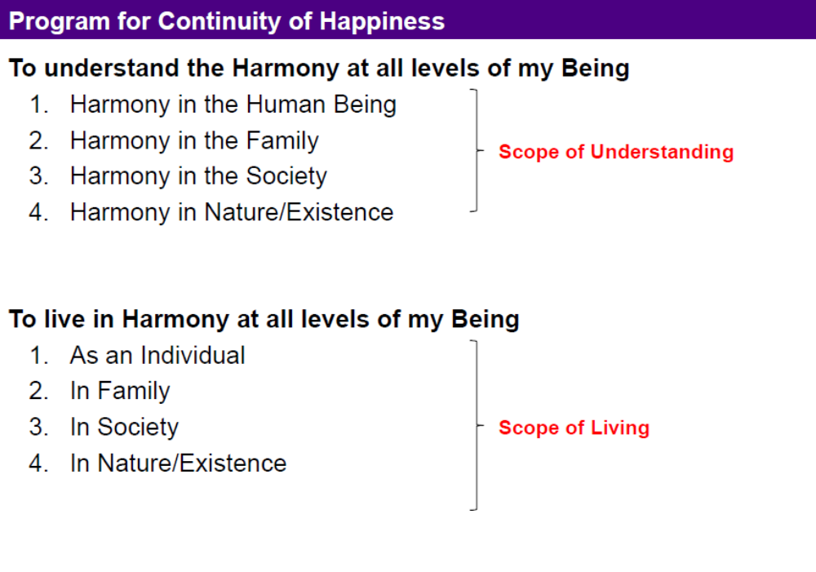
Continuous happiness and prosperity

Slide 21
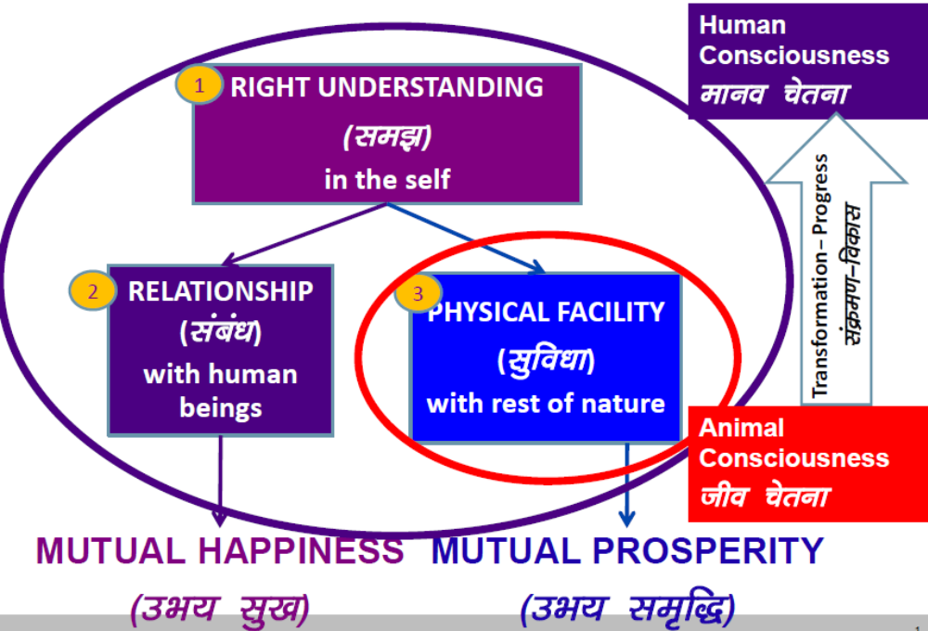
Right understanding

Slide 22
Right understanding
Our basic aspirations are happiness (mutual fulfillment) and prosperity (mutual prosperity). Happiness is ensured by the relationships with other human beings and prosperity is ensured by working on physical facilities.
Right Understanding: This refers to higher order human skills – the need to learn and utilize our intelligence most effectively.
Good Relationships: This refers to the interpersonal relationships that a person builds in his or her life– at home, at the workplace and in society.
Physical Facilities: This includes the physiological needs of individuals and indicates the necessities as well as the comforts of life. It means the feeling of having or being able to have more physical facilities than is needed.
Right understanding + Relationship = Mutual fulfillment.
Right understanding + Physical facilities = Mutual prosperity.

Slide 23


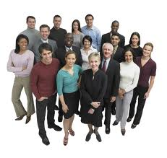
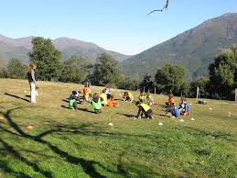
Understand and live in Harmony at All Level of Livings:
Living in Myself
Living in Family
Living in Society
Living in Nature/Existence

